Slide 1


WHAT ?
Gamma Is A Presentation Tool Designed To Redefine The Way We Present Ideas.
It Allows You To Present Ideas And Information In A Condensed Form Using Text, Images, And Graphics.
With Gamma, You Can Generate Documents, Presentations, And Webpages In Mere Seconds, Ensuring That Your Content Is Not Only Informative But Also Visually Appealing.
GAMMA AI
A REVOLUTION IN CONTENT CREATION

Slide 2
WHAT ?
Presentation Tool Designed To Redefine The Way We Present Ideas.
Present Ideas And Information In A Condensed Form.
Generates Documents, Presentations And Webpages In Mere Seconds

Slide 3


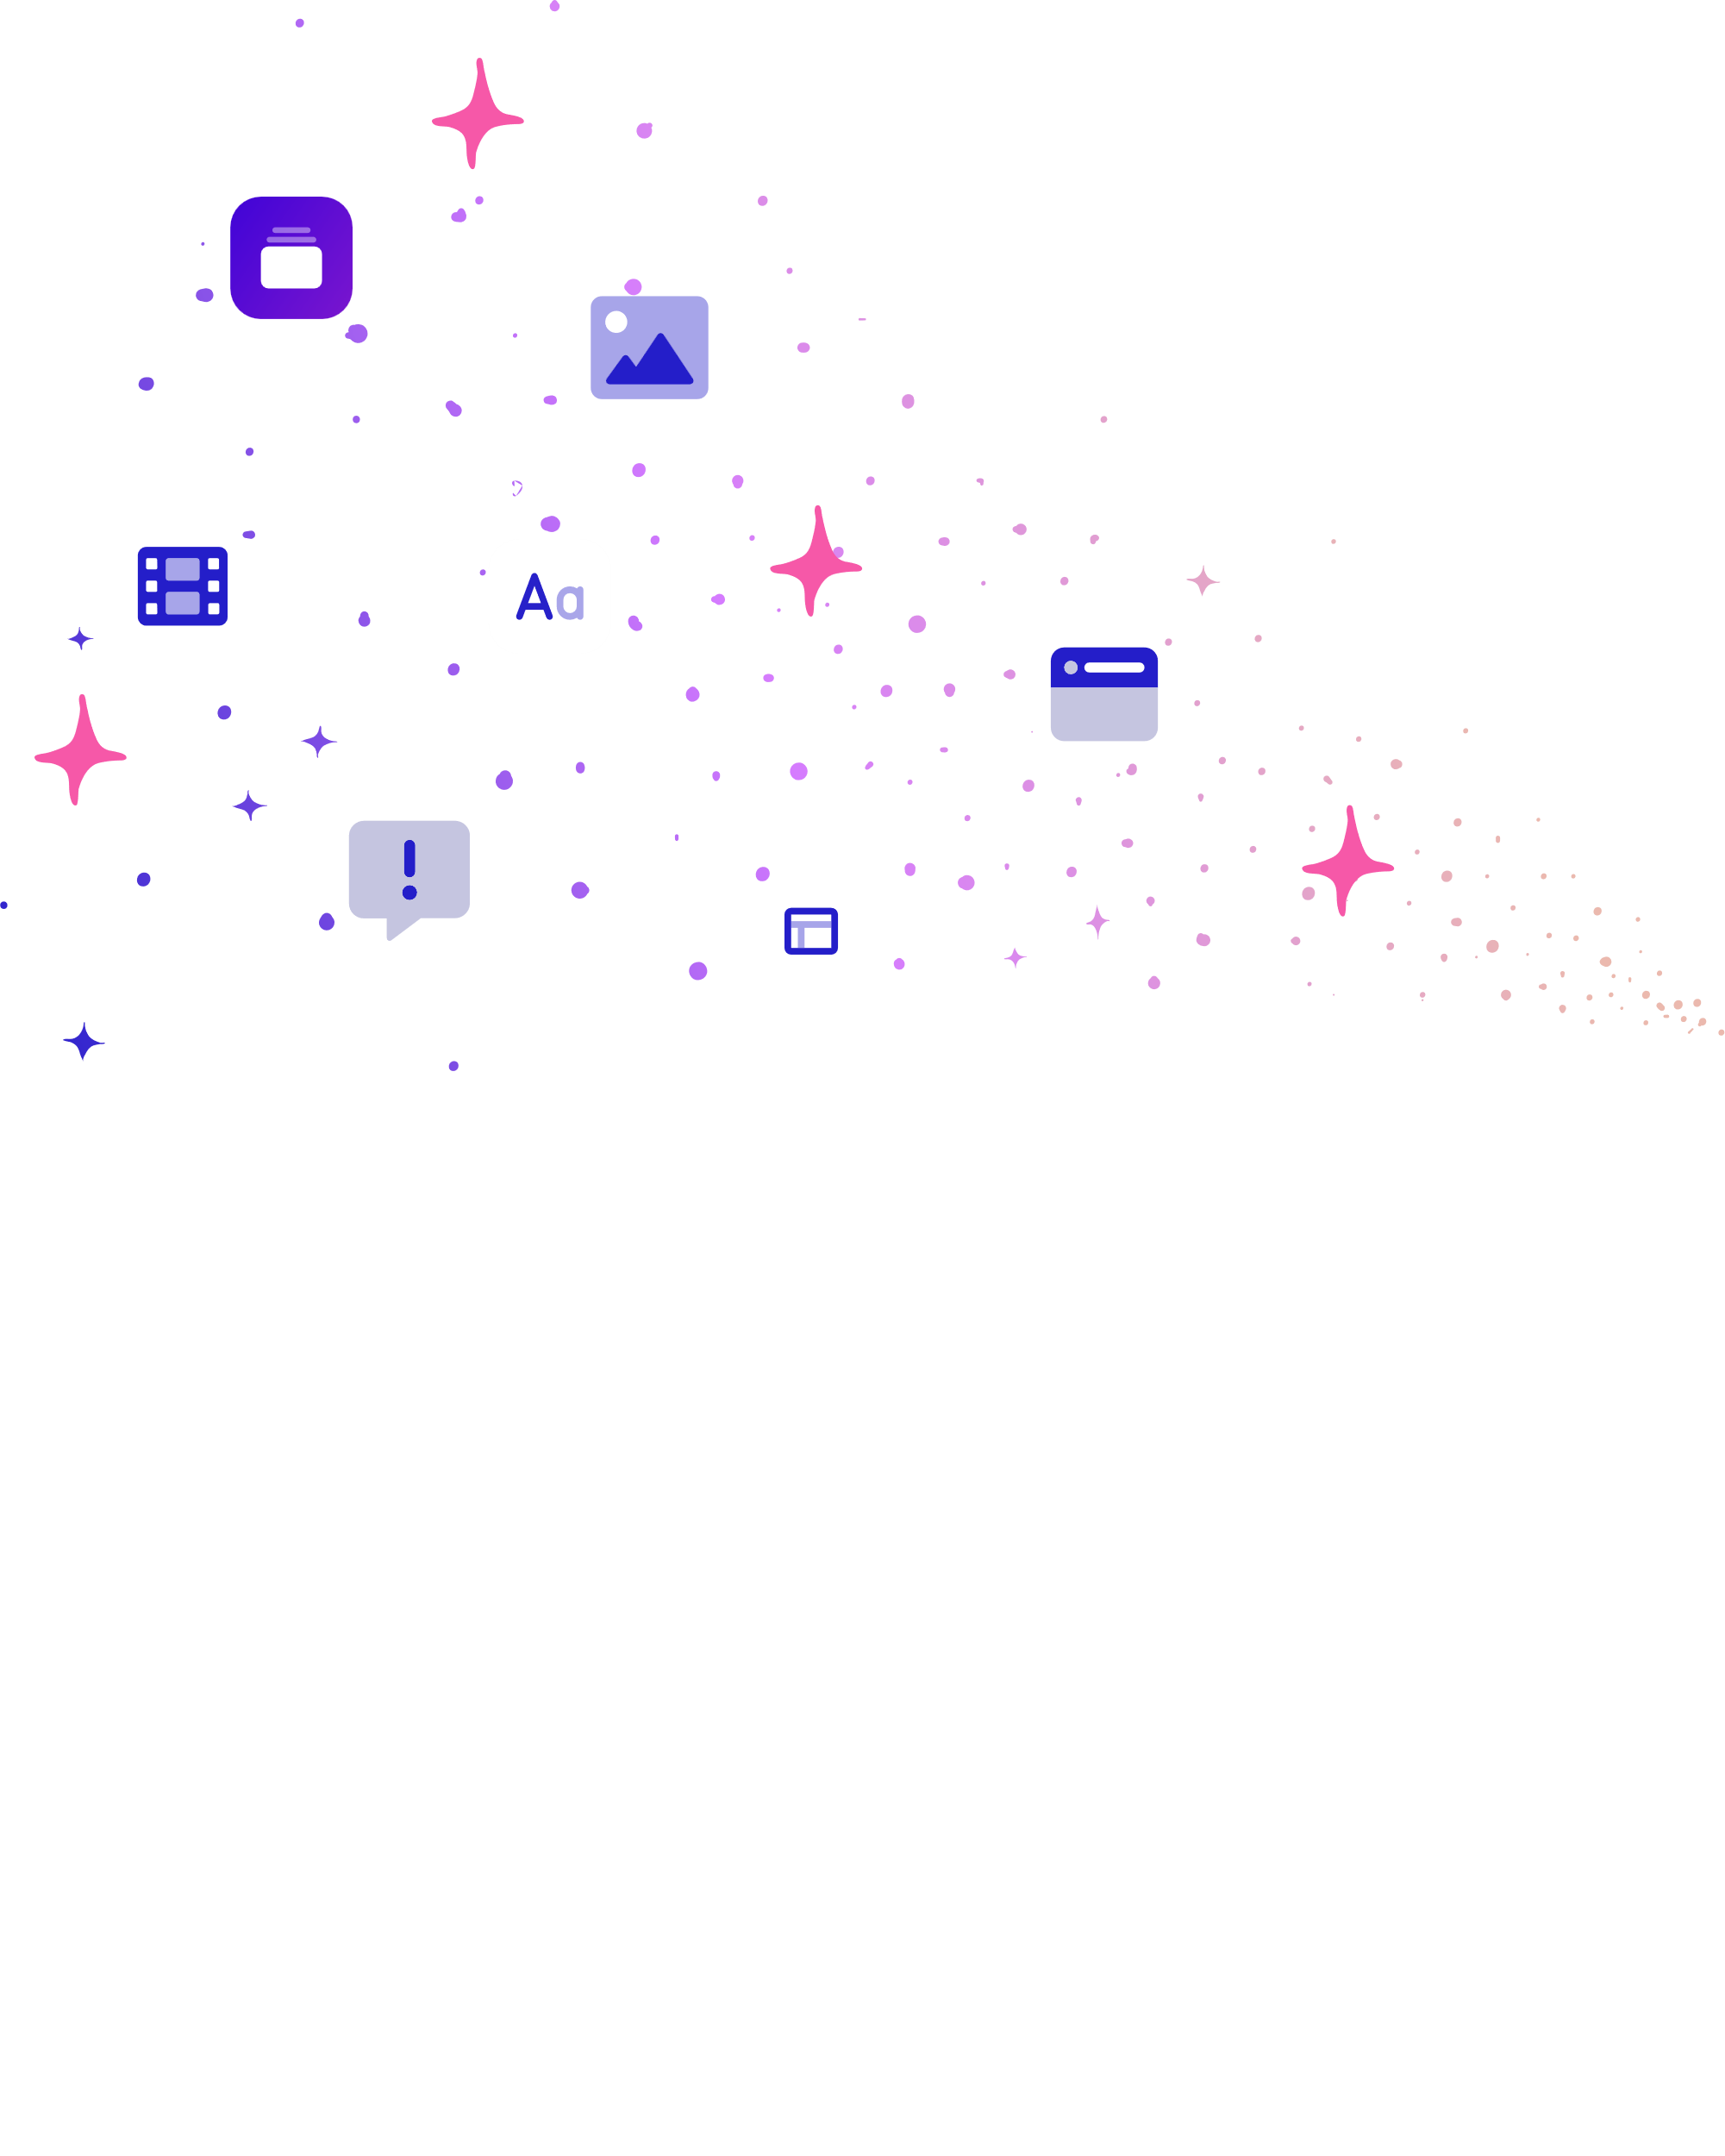


WHEN ?
Launched in 2020
By Jon Noronha
& Salim Khaki

Slide 4





1
INPUT
2
NLP Analysis
HOW?
3
Content Generation
4
Customization
5
Finalization
PRE-TRAINED
MODELS
LARGE LANGUAGE MODELS
REINFORCEMENT
LEARNING

Slide 5
HOW?
PRE-TRAINED
MODELS
LARGE LANGUAGE MODELS
REINFORCEMENT
LEARNING

Slide 6





APPLICATIONS
AI-powered content generation
Effortless design
Seamless collaboration
Intuitive interface
FEATURES
AI
POWERED
EFFORTLESS DESIGN
SEAMLESS COLLABORATION
INTUITIVE INTERFACE

Slide 7
APPLICATIONS

Slide 8

PERSONAL USE

Slide 9

MARKETING

Slide 10


EDUCATION

Slide 11
BUSINESS

Slide 12
IMPLEMENTATION

Slide 13
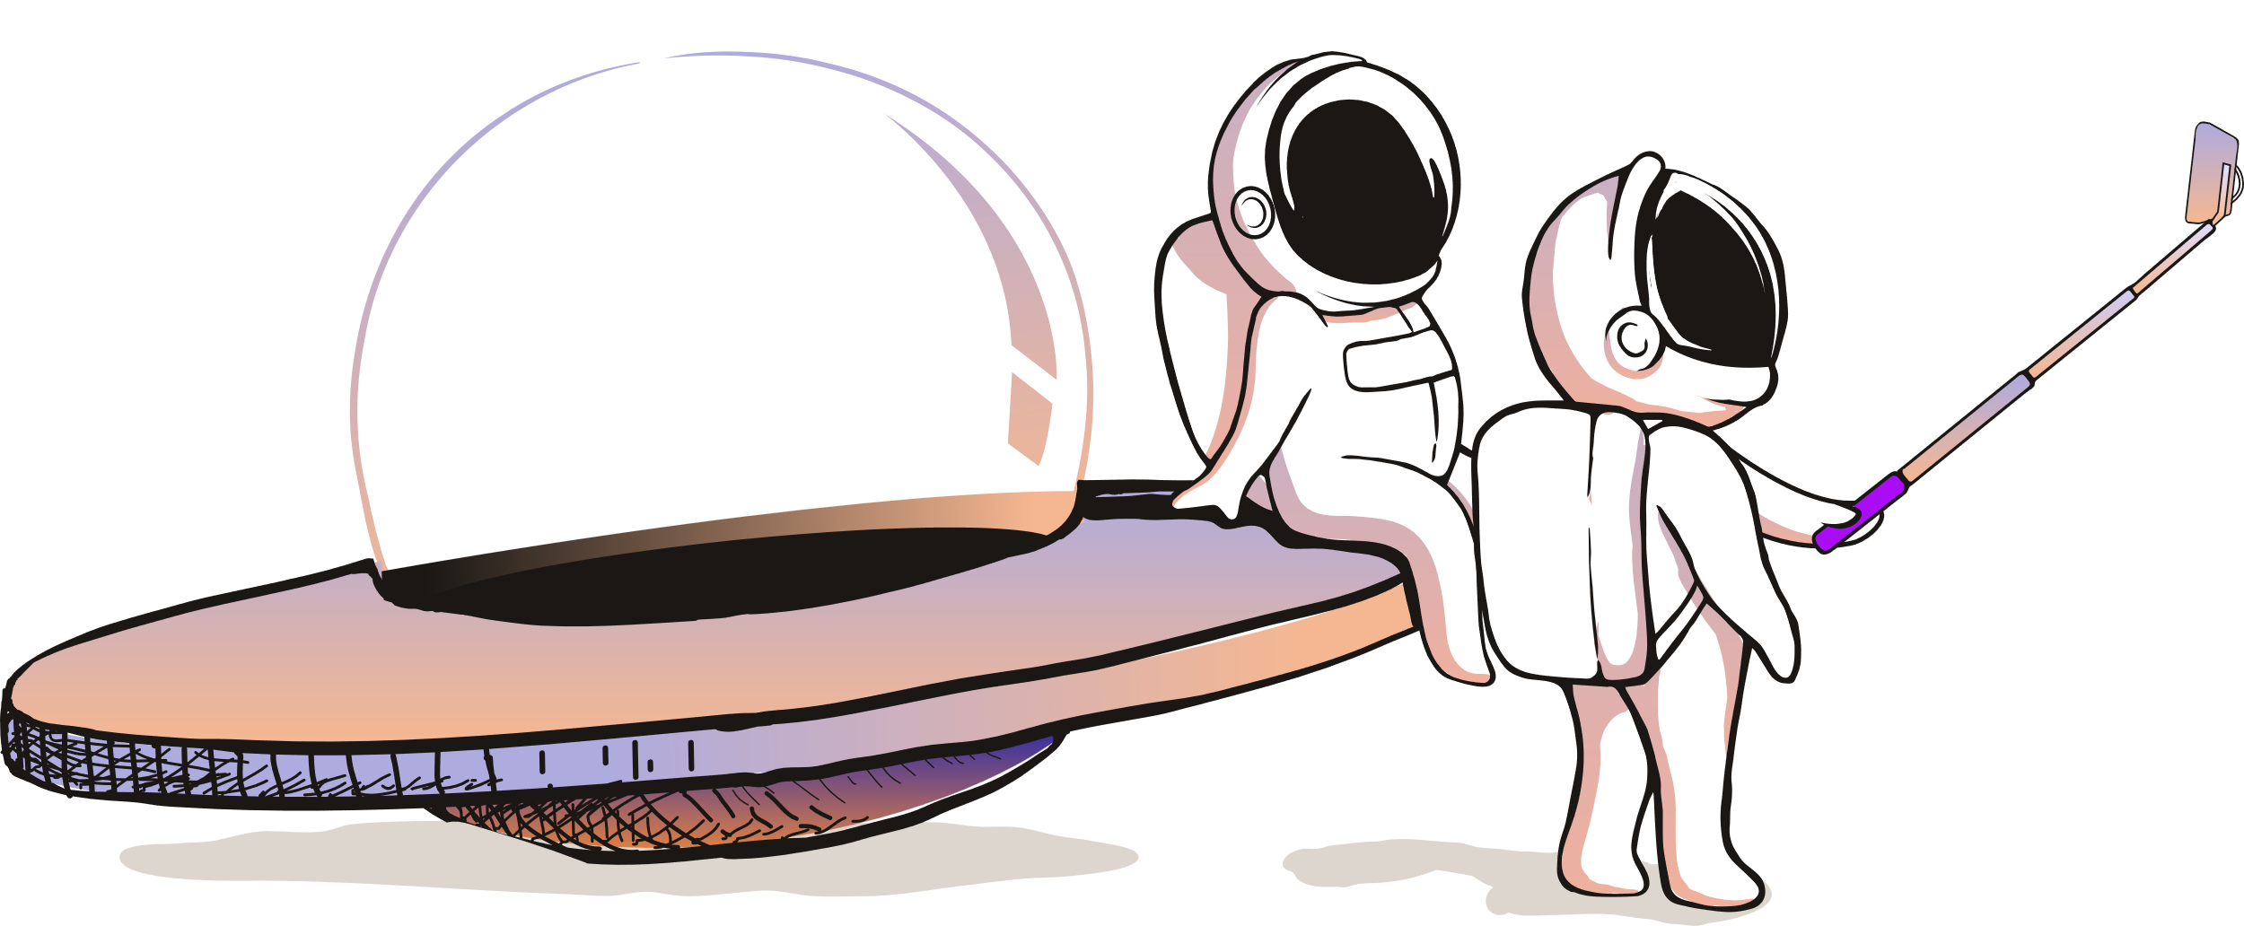
THANK
YOU

